Slide 1
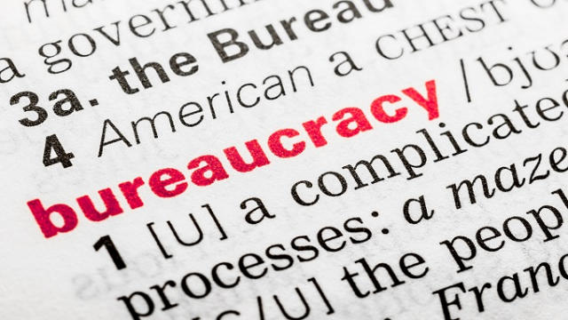
Bureaucracy

Slide 2
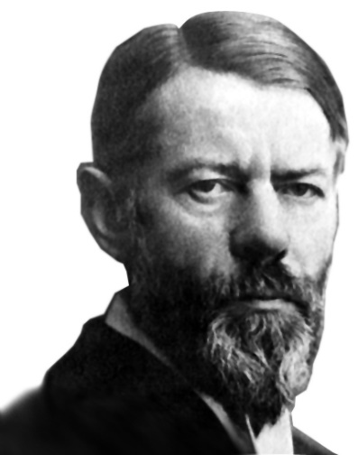
Max Weber :Bureaucracy (Prussia)
Key characteristics of Bureaucracy: Fixed rules, authority, fixed in forms of memos and sometimes computerized.
Activities are distributed in a fixed way- i.e only certain groups get certain duties- IRS (income tax)
Authority is stable and top down, subject to fixed rules
Continuous fulfillment of duties.
Management is expert trained and sets rules in codified(memos) form.
Officials must work in full capacity

Slide 3
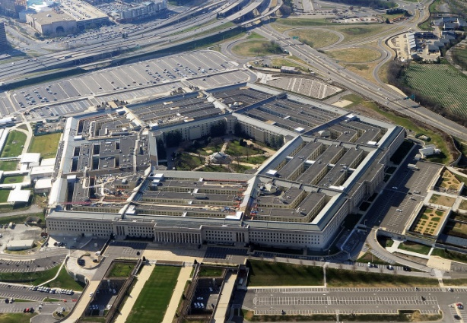
Weber (cont)
United States is the best form of a bureaucracy with mix of private economy and public bureaucracy. Example-Pentagon or ICC
Democratization only exists in elections, not the bureaucracy-it’s hierarchical.
Bureaucracy should be open and transparent to the people but not to be dismantled or reformed by the people. Leave that to Congress and the President.
Operates like a machine with vital cogs in it-workers and is closely tied to the capitalist model. Communication is controlled by bureaucracy, as well as the rational structure of authority- hard to fire people.

Slide 4
Peter Woll:Constitutional Democracy/Bureaucratic power
Bureaucracy is the “fourth branch”
Independent discretion-Pres. appoints heads, Senate Confirms, Congress authorizes funds-appropriations.
Judicial branch will only review if lawsuit is filed against agency.
Quasi mini government.
Policy making power
Indirectly interacts with constituents they serve. Congress is elected by people, but they give policy power to bureaucracies.
Congress can alter or abolish agencies, make laws to replace agency policies

Slide 5
Bureaucracy
*Congress can set an agencies budget but rarely will withhold funding.
Agencies can act beyond presidential control because they can disagree with his views and there is little that the president can do legally to control them.
Agencies and bureaus perform their own checks and balances on each other and do not have symmetry with the president, courts or congress. Equal constitutional responsibilities.

Slide 6
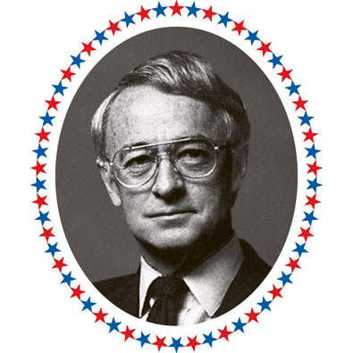
James Q Wilson: Hand Over Heart
Bureaucracies are like modern life: complex, inefficient etc.
Connected with corporations and capitalist model.
Post office and Department of Defense interact with private economy, have large staffs and budgets.
Clientelism- Serving public and private interests, USDA, Veteran’s affairs, pensions, Social Security.
ICC or Interstate Commerce Commission is a unique blend of public/private regulation. Gas, railways, trucking trains.
Hard to eliminate clientele groups because they provide lots of services and will work to protect factional interests. FED 10 and 39.

Slide 7
Essay Topics: Unit VIII Executive Branch
Presidential Honeymoon: Not what you think it may be!
Victories vs. Congress
ex: First year in office: 2017-2018
Wilson: Hand over Heart, page 348
Conclusion? It should __________ after year one
Gerald Ford is unique right? Why?

Slide 8
Essay Topics: Unit VIII Part Deux
Bureaucracies-
Patholgy-
What are the pathologies of bureaucracies?
What Causes them? (Thesis)
Examples?

